Slide 1
ST. JOSEPH HOSPITAL GALLERY 2023

Slide 2
MATRON 360 REPORT 2023
WARDS | MARKS | POSITION | UNITS | MARKS | POSITION | DEPARTMENT | MARKS | POSITION
SURGICAL | 78.2 | 7TH | THEATRE | 52.8 | 2ND | ADMINISTRATION | 36.2 | 7TH
FEMALE MED. | 84.8 | 2ND | DENTAL | 39.8 | 7TH | RECORDS | 40.6 | 5TH
MALE MED. | 79.2 | 4TH | EYE/ENT | 42.6 | 6TH | PHARMACY | 42.8 | 4TH
GENERAL | 77.8 | 8TH | ANC | 53.0 | 1ST | SECURITY | 17.67 | 10TH
CHILDREN | 79.0 | 5TH | MENTAL | 40.6 | 7TH | LABORATORY | 47.2 | 1ST
MATERNITY | 82.0 | 3RD | PHU | 49.8 | 4TH | X-RAY | 37.0 | 6TH
NICU | 90.0 | 1ST | VCT | 50.2 | 3RD | OPD | 46.8 | 2ND
EMERGENCY | 78.4 | 6TH | PHYSIO | 46.0 | 5TH | STORES | 33.0 | 8TH
 |  |  | KITCHEN | 32.8 | 10TH | MORTUARY | 43.0 | 3RD
 |  |  | LAUNDRY | 34.8 | 9TH | MAINTENANCE | 19.5 | 9TH

Slide 3
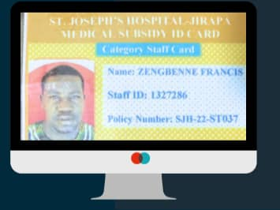
STAFF MEDICAL SUBSIDY POLICY

Slide 4
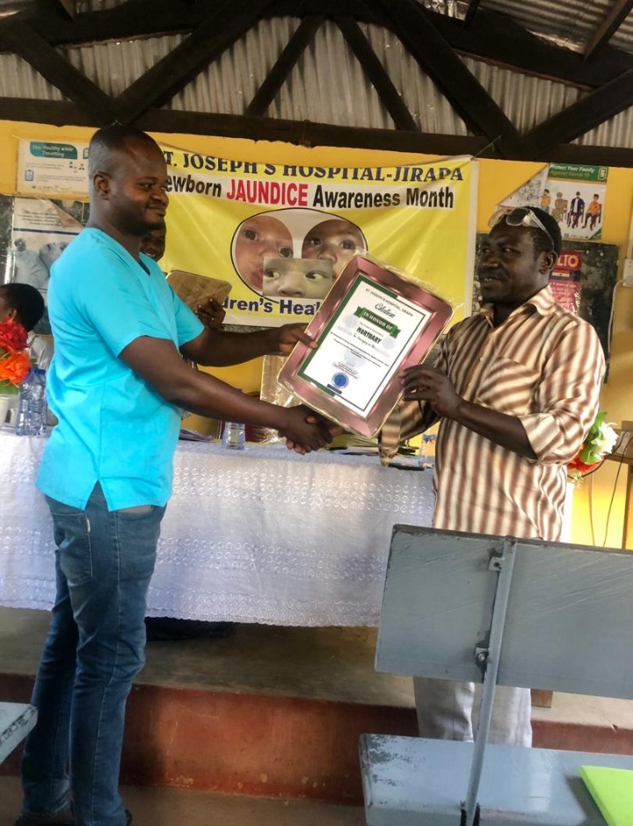
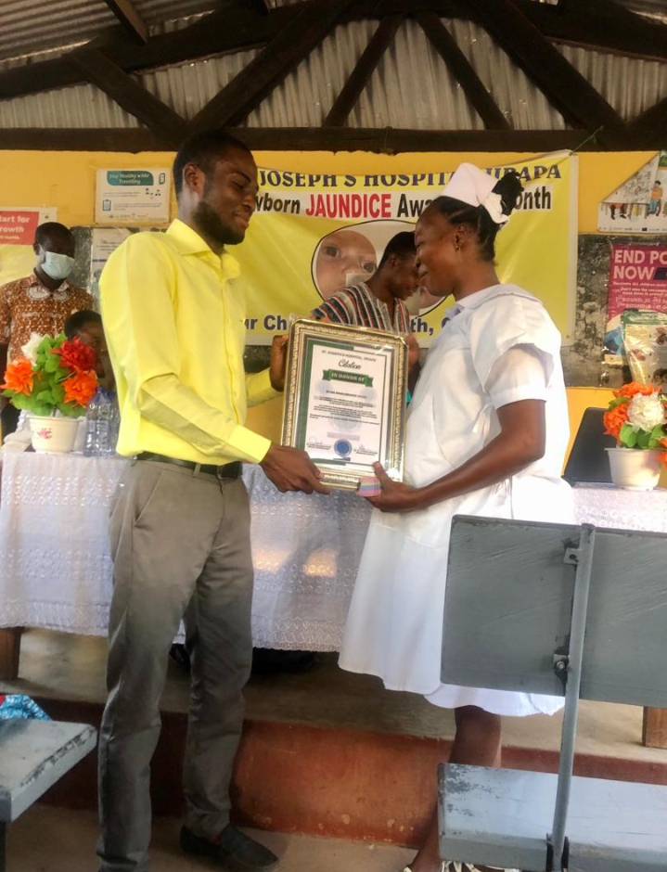
END OF YEAR STAFF AWARDS 2022
OVERALL BEST STAFF
BEST DEPARTMENT

Slide 5
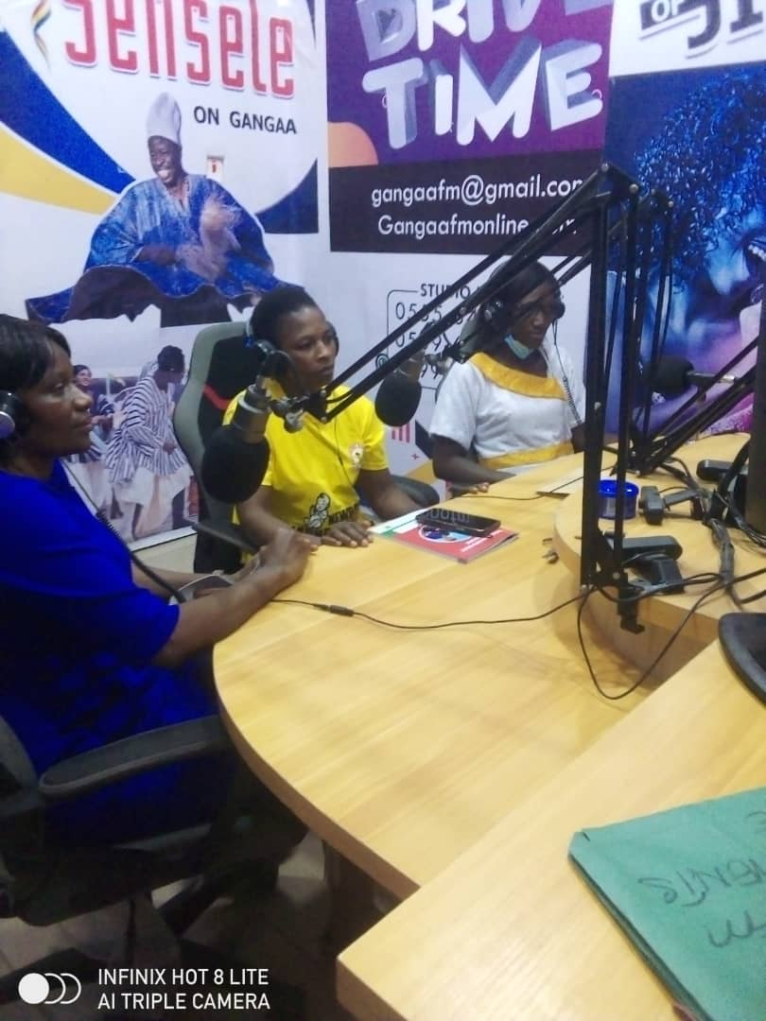
TWICE WEEKLY HEALTH TALKS AT RADIO GANGAA

Slide 6
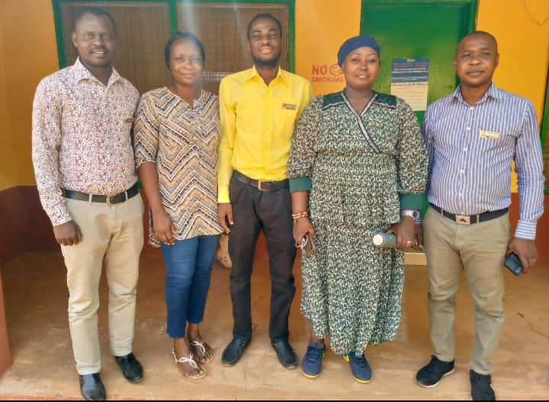
MENTAL HEALTH AUTHORITY – REHAB AND ADDICTION TRAINING PROGRAM

Slide 7
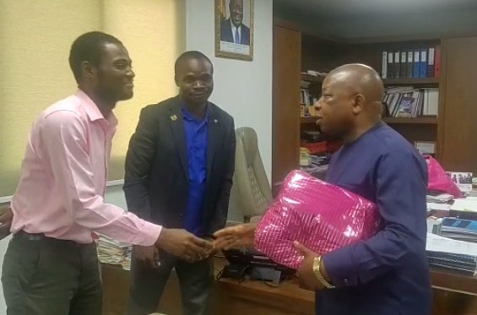
APPOINTMENT WITH MINISTER OF HEALTH

Slide 8
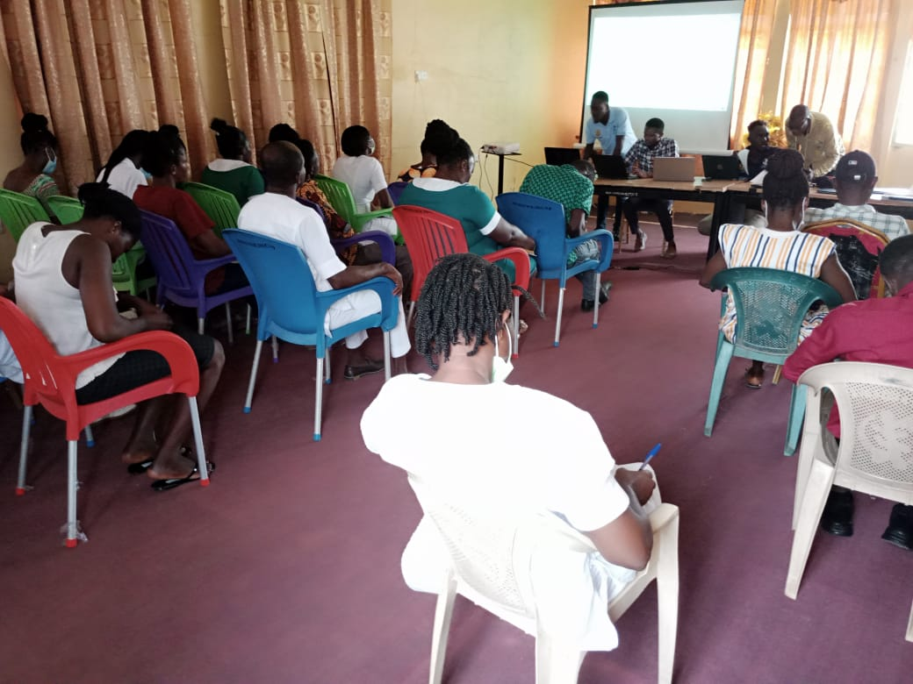
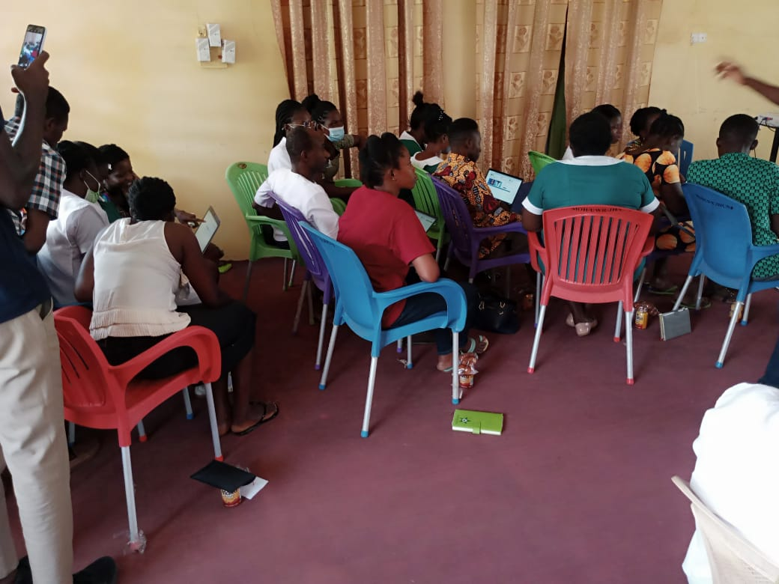
LIGHTWAVE HEALTH INFORMATION MANAGEMENT (LHIMS) STAFF TRAINING

Slide 9
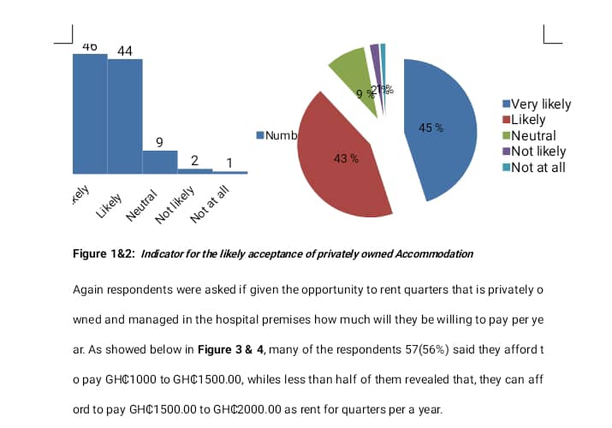
B.O.T - STAFF ACCOMMODATION SURVEY

Slide 10
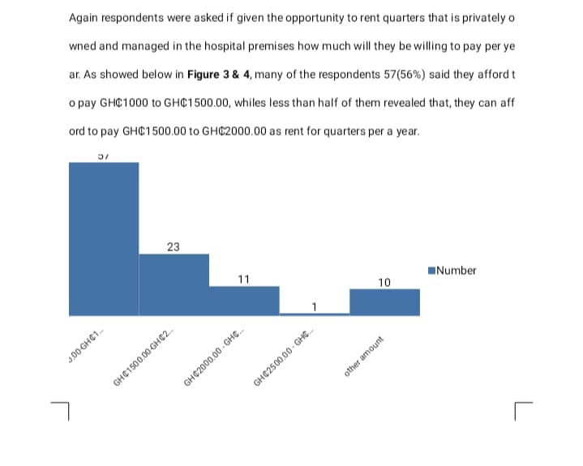

Slide 11
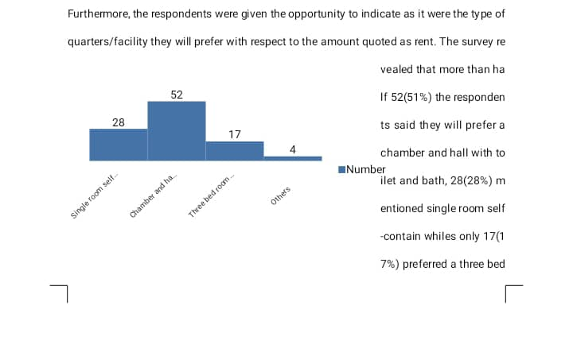

Slide 12
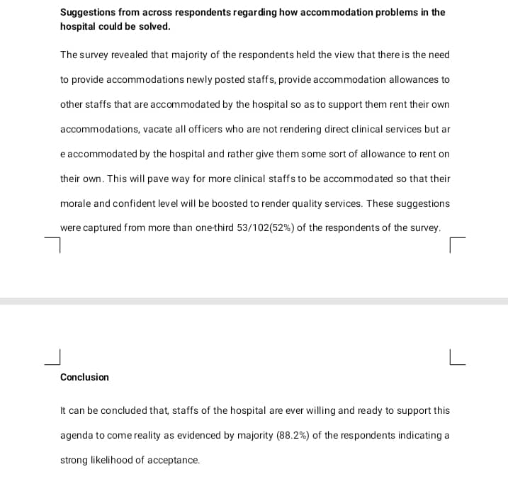

Slide 13
CLIENT SATISFACTION SURVEY (JUNE 2023)
QUESTION | YES DEFINITELY | YES MOSTLY | NEUTRAL | NO, NOT REALLY | NO, NOT AT ALL
SAFETY AND SECURITY DURING STAY | 50% | 30% | 7% | 7% | 6%
STAFF KNOWLEDGE AND COMPETENCE | 68% | 25% | 4% | 1% | 2%
WAS PAIN ADEQUATELY MANAGED | 49% | 35% | 9% | 4% | 3%
EMOTIONAL SUPPORT PROVIDED | 28% | 33% | 17% | 8% | 14%
PRIVACY RESPECTED | 59% | 32% | 4% | 4% | 1%
CLEAR INSTRUCTIONS GIVEN ON HOW TO MANAGE CONDITION | 51% | 30% | 3% | 8% | 8%
POTENTIAL RISKS/BENEFITS OF TREATMENT EXPLAINED | 46% | 36% | 7% | 5% | 6%
CULTURE/RELIGION RESPECTED | 54% | 32% | 11% | 3% | 0%
FINANCIAL SUPPORT + NHIS | 42% | 41% | 10% | 7% | 0%
INFO POLICIES/PROCEDURES | 11% | 15% | 5% | 8% | 61%
INFO ON TREATMENT COMPLICATIONS | 41% | 40% | 8% | 4% | 7%
OPPORTUNITY TO GIVE FEEDBACK | 14% | 15% | 9% | 7% | 55%

Slide 14
QUESTION | YES SATISFIED | SATISFIED | NEUTRAL | DISSATI- SFIED | VERY DISSATISIED
WAITING TIME FOR APPOINTMENTS | 7% | 13% | 6% | 23% | 52%
AVAILABILITY OF PARKING FACILITIES | 9% | 21% | 62% | 5% | 3%
RANGE OF SERVICES OFFERED | 25% | 59% | 9% | 7% | 0%
QUALITY AND VARIETY OF MEALS | 11% | 15% | 5% | 8% | 61%
INTERDEPARTMENT COMMUNICATION | 7% | 13% | 77% | 1% | 2%
FACILITY CLEANLINESS AND HYGIENE | 32% | 58% | 3% | 6% | 1%
STAFF RESPONSE TO NEEDS/CONCERNS | 56% | 31% | 6% | 6% | 1%
INVOLVEMENT IN DECISION-MAKING | 30% | 37% | 10% | 11% | 12%
EFFECTIVENESS OF COMMUNICATION | 31% | 46% | 14% | 9% | 0%
ACCESSIBILITY AND CONVENIENCE OF SERVICES | 6% | 53% | 30% | 8% | 3%
COORDINATION OF CARE WITH STAFF | 7% | 53% | 36% | 0% | 4%
ADDRESSING OF LANGUAGE BARRIER | 70% | 20% | 6% | 4% | 0%
FACILITIES FOR INDIVIDUALS WITH DISABILITY | 2% | 19% | 56% | 19% | 4%
*LIKELIHOOD OF RECOMMENDING | 25% | 64% | 6% | 3% | 2%

Slide 15
ANY OTHER THINGS TO SHARE (CLIENT)
FRIENDLY STAFF
SATISFIED WITH SERVICES
LONG WAITING TIME – ESPECIALLY AT RECORDS, LABORATORY, OPD AND X-RAY DEPARTMENTS WITH NO COMMUNICATION AND ENCOURAGEMENT FROM STAFF
POOR ATTITUDE OF SOME STAFF – ESPECIALLY AT RECORDS, NURSING, MATERNITY, BILLING UNIT
DIFFERENT DIET FOR SOME PATIENT EG. ULCER PATIENTS
BILLING TOP-UPS FOR MEDICATION AND SERVICES ARE HIGH
HIGH COST OF GLUCOSE STRIPS ON WARDS
LABORATORY STAFF EXTORT MONIES FROM CLIENT
GOOD ATTITUDE FROM NURSES AND DOCTORS
RELIGIOUS WARD HAS GOOD SERVICES BUT HIGH USER FEES
OVERTAKING AND JUMPING QUEUS ENCOURAGED AT OPD
ELECTRONIC HEALTH RECORDS SYSTEM CAUSING DELAYS
INTRODUCE SPECIAL TREATMENT FOR ELDERLY AT OPD

Slide 16
MENTAL HEALTH AUTHORITY – REHAB AND ADDICTION TRAINING PROGRAM

Slide 17
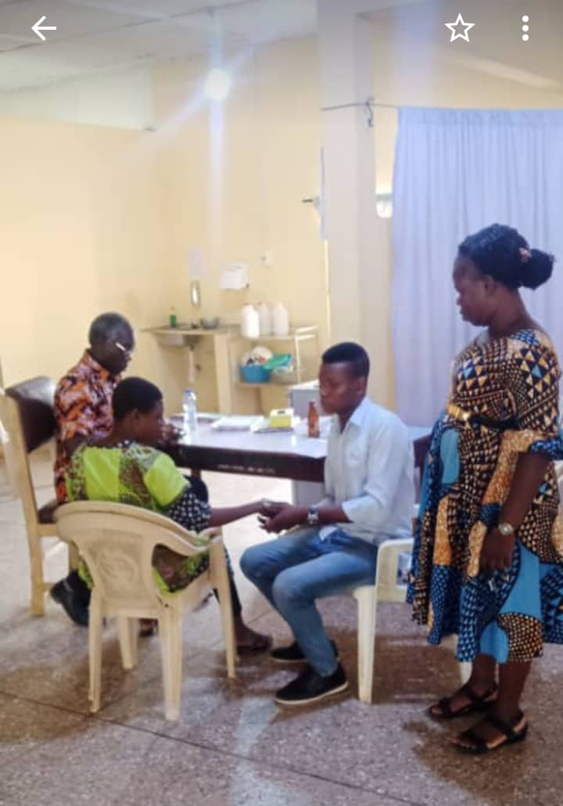
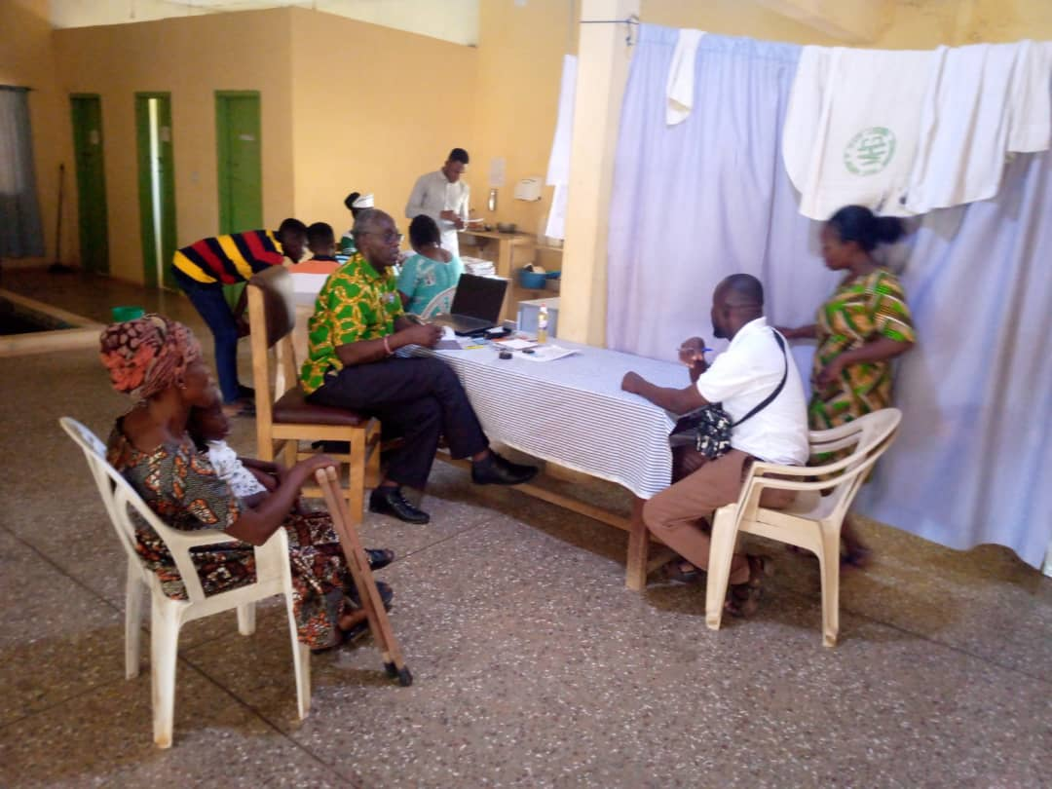
BIANNUAL NSAWAM PHYSIOTHERAPISTS VISIT

Slide 18
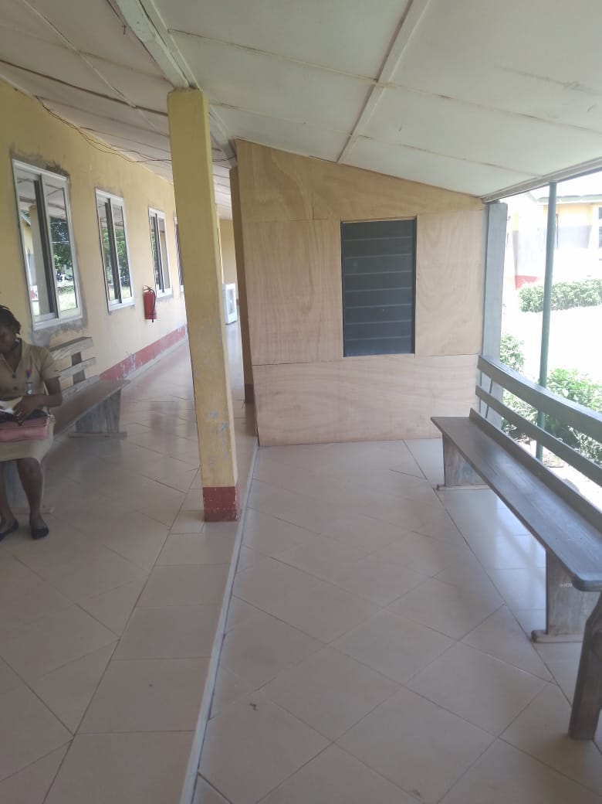
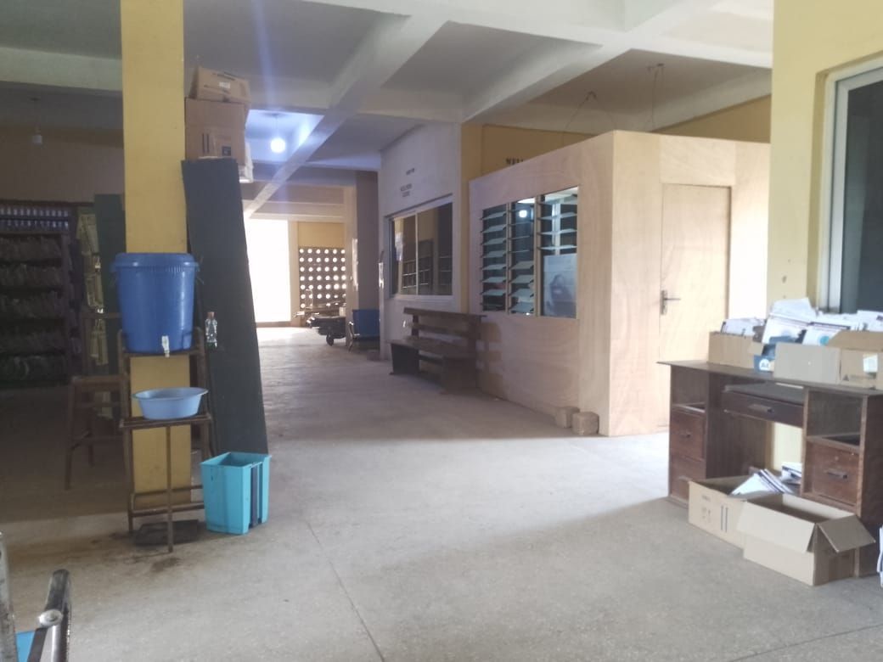
BILLING UNITS

Slide 19
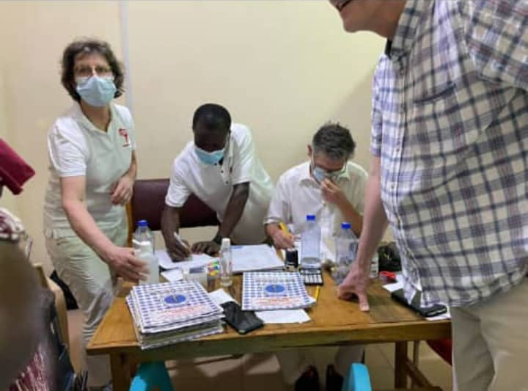
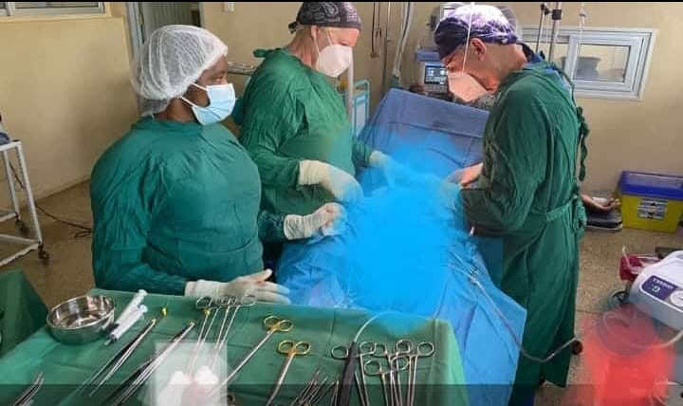
BIANNUAL GERMAN UROLOGISTS VISIT

Slide 20
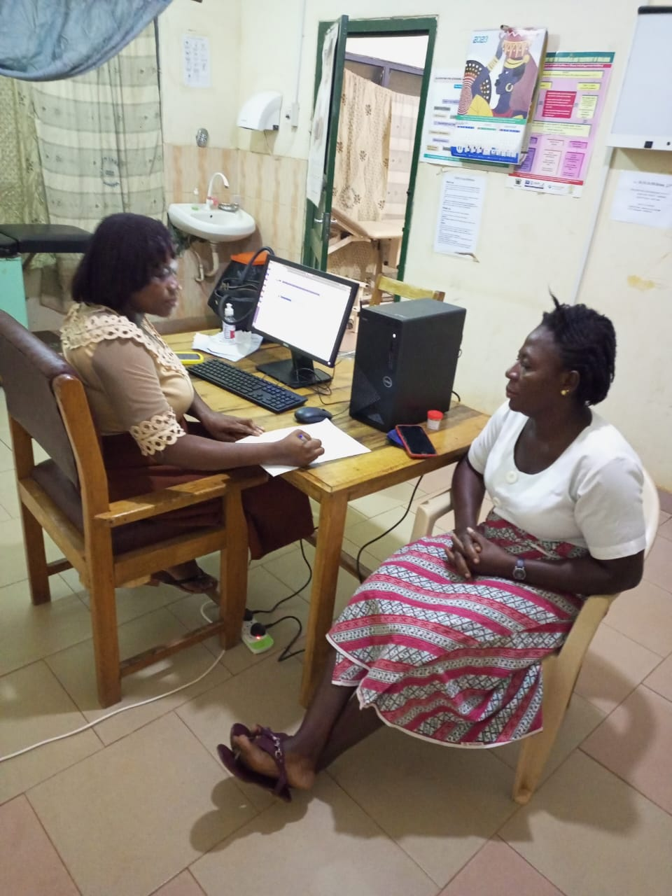
ANNUAL STAFF HEALTH SCREENING

Slide 21
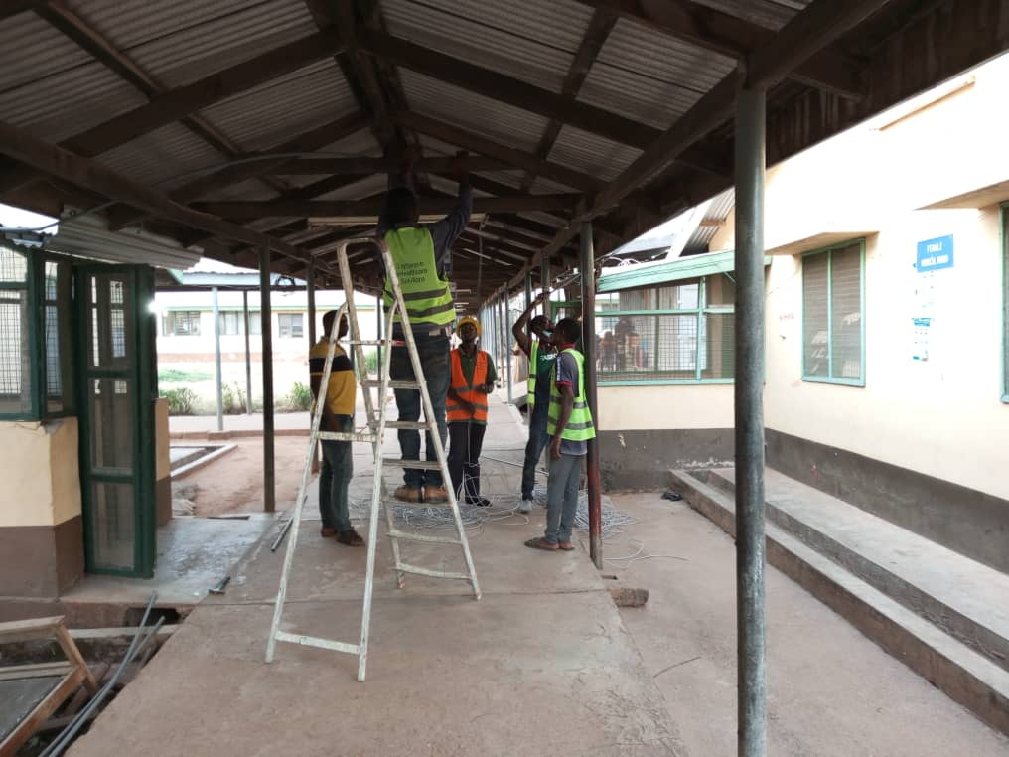
PHASE I OF ELECTRONIC HEALTH RECORDS SYSTEM - LHIMS

Slide 22
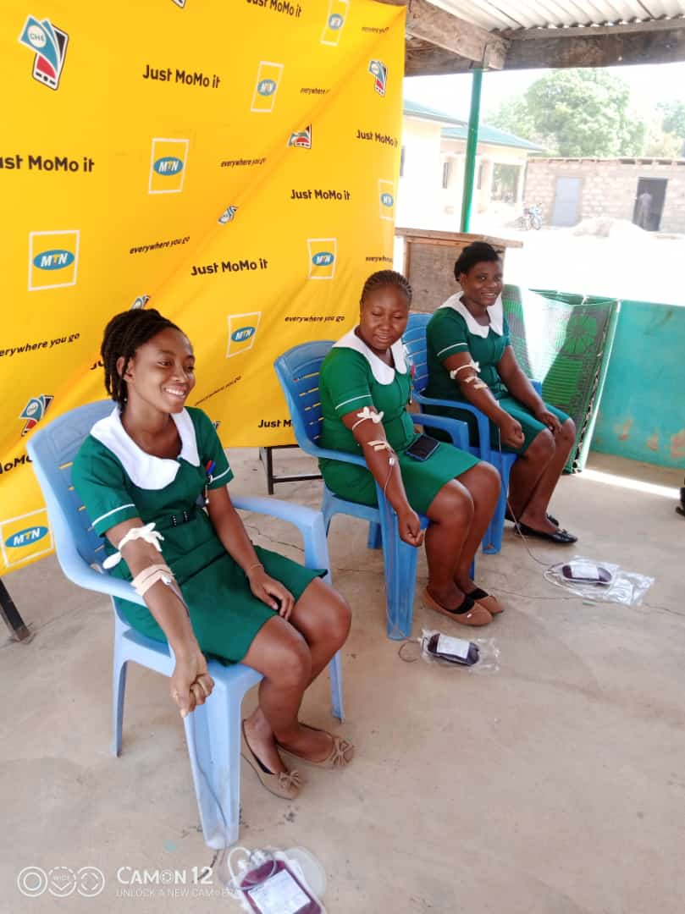
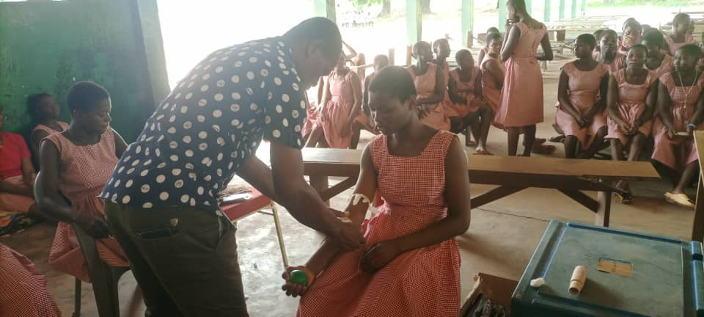
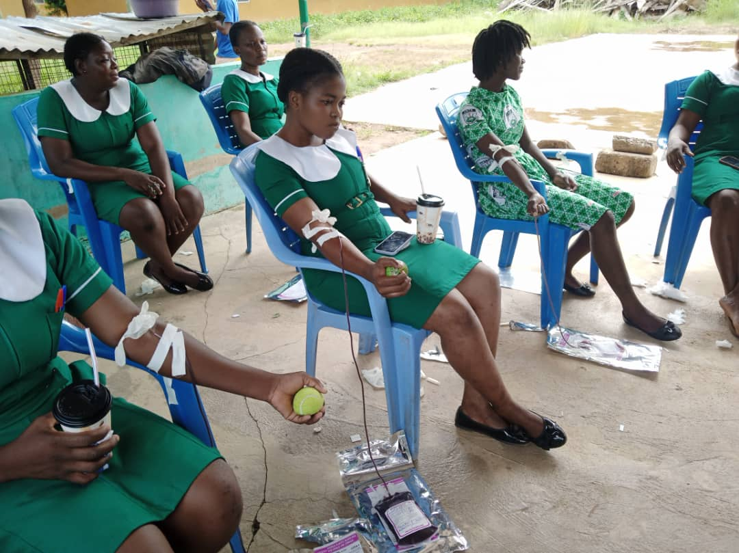
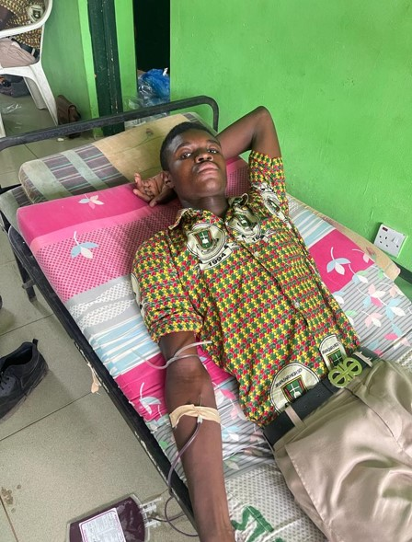
QUARTERLY VOLUNTARY BLOOD DONATION EXERCISE
ST. JOSEPH NURSING/MIDWIFERY COLLEGE
MTN SPONSORED
ST. FRANCIS GIRLS’ SENIOR HIGH SCHOOL
ST. JOSEPH NURSING/MIDWIFERY COLLEGE
FDA SPONSORED
JIRAPA SENIOR HIGH SCHOOL

Slide 23
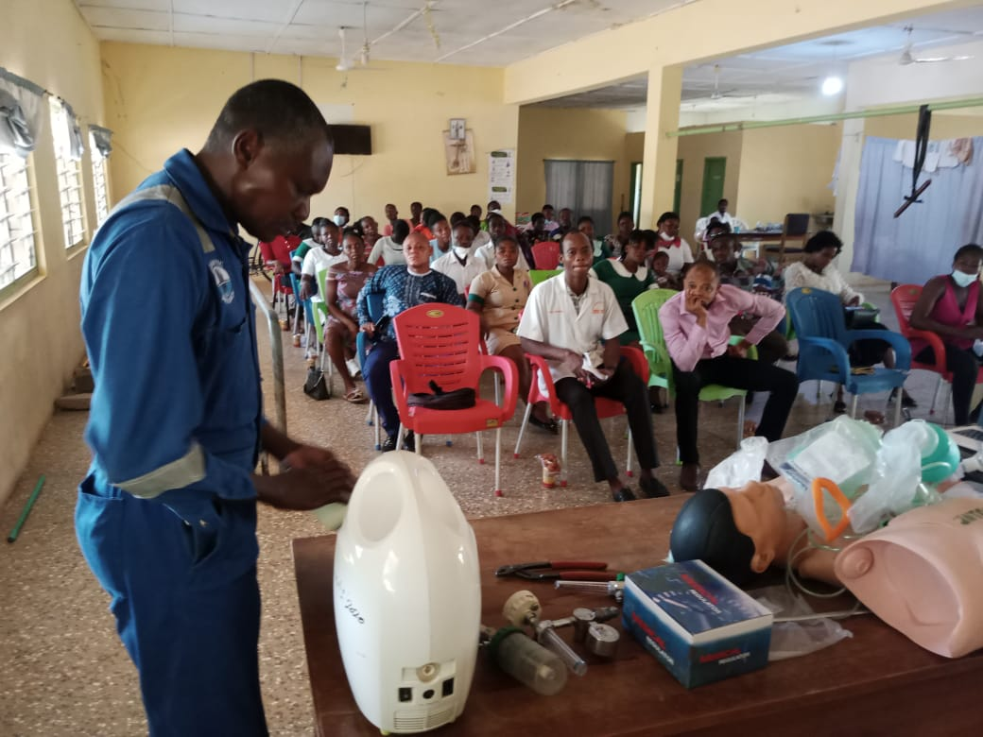
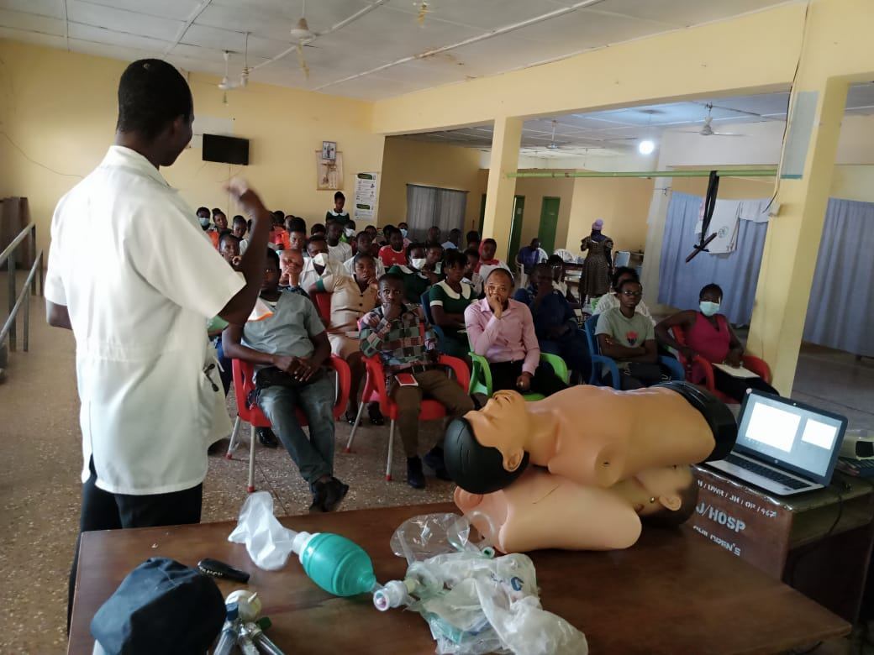
IN-SERVICE TRAINING
MEDICAL EQUIPMENT CARE
MANAGEMENT OF MEDICAL EMERGENCIES

Slide 24
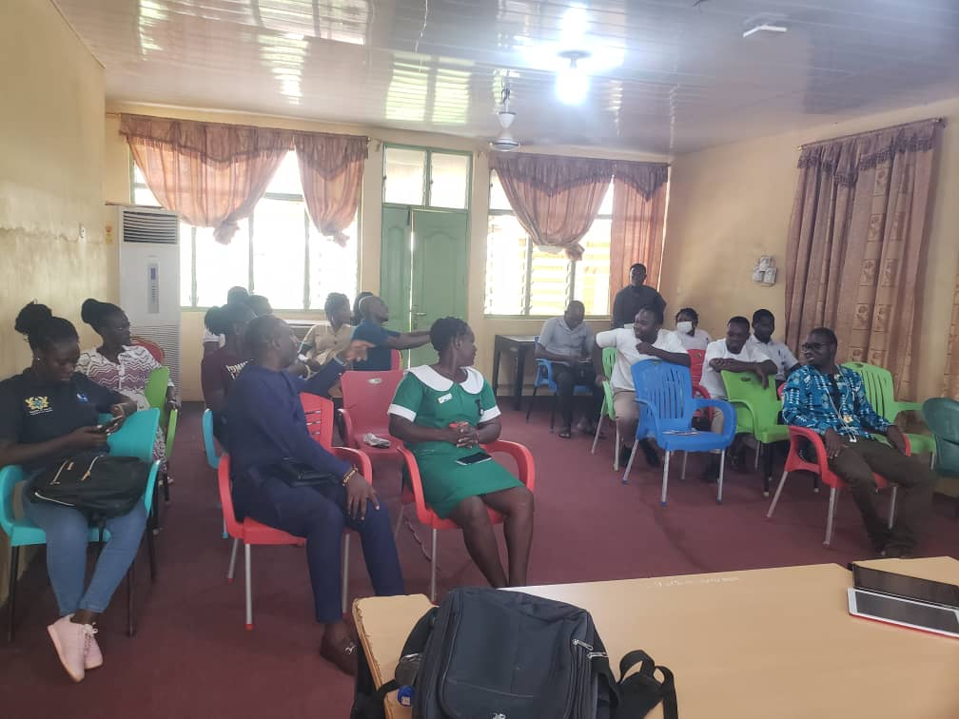
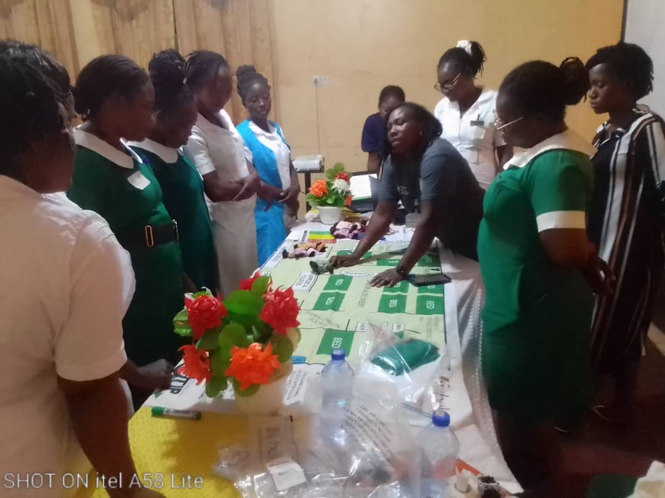
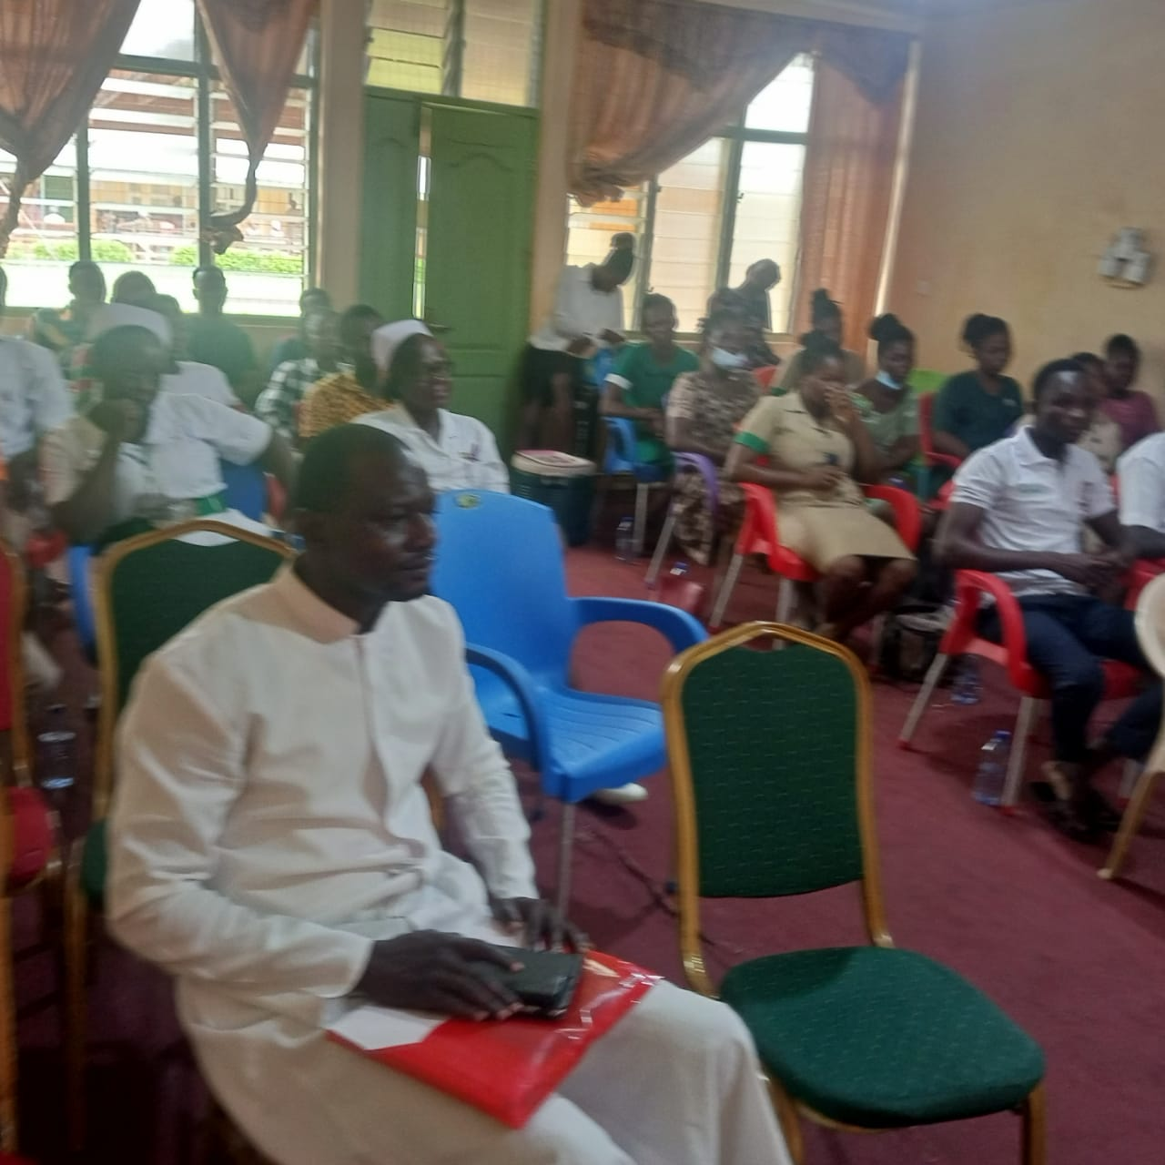
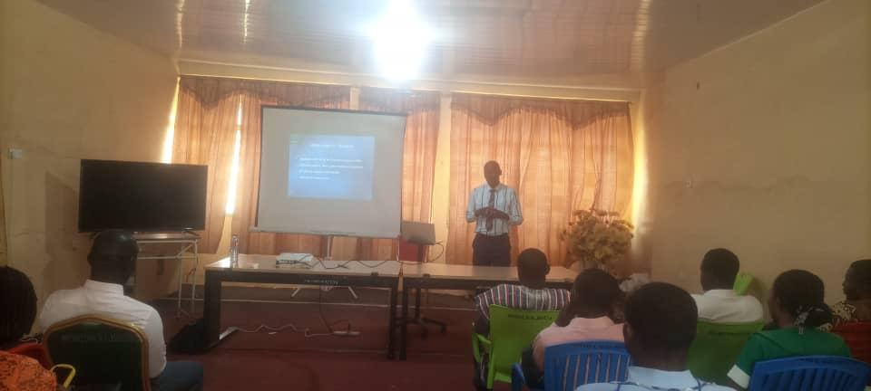
IN-SERVICE TRAINING
BABY REGISTRATION - LHIMS
OBSTETRIC TRIAGING
BLOOD TRANSFUSION ETHICS
ORIENTATION OF NEW STAFF

Slide 25
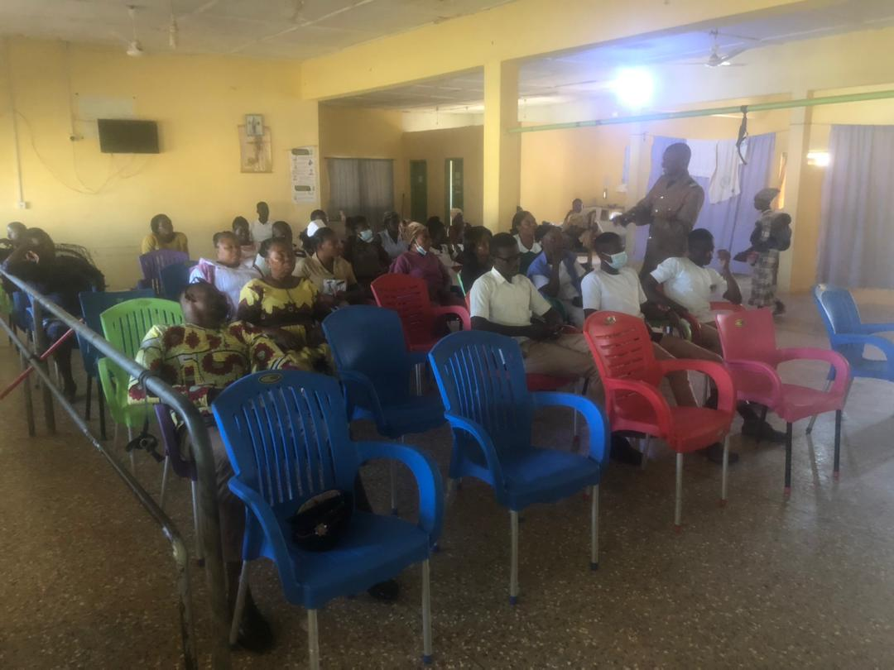
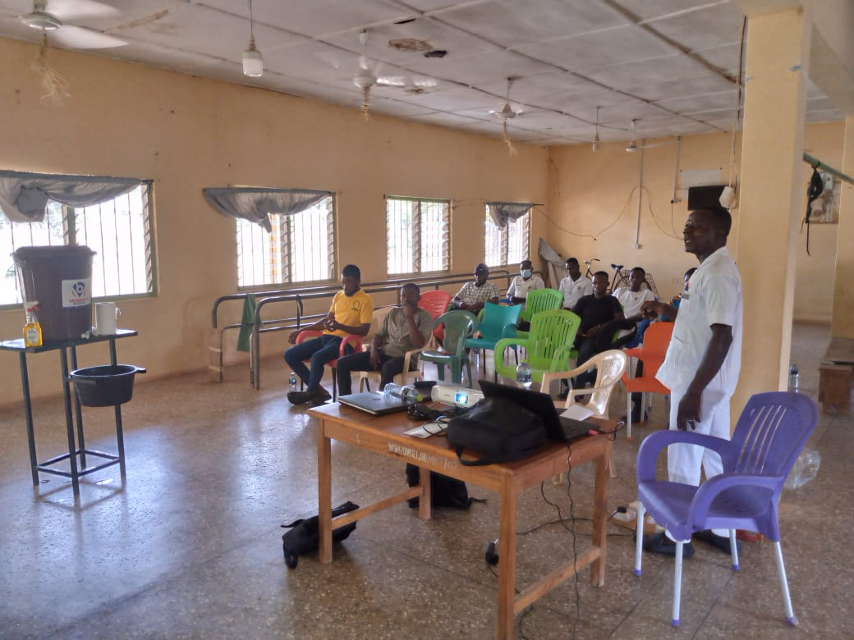
IN-SERVICE TRAINING
FIRE SAFETY TRAINING + SIMULATION EXERCISE
IPC + LHIMS TRAINING FOR NEW STAFF

Slide 26
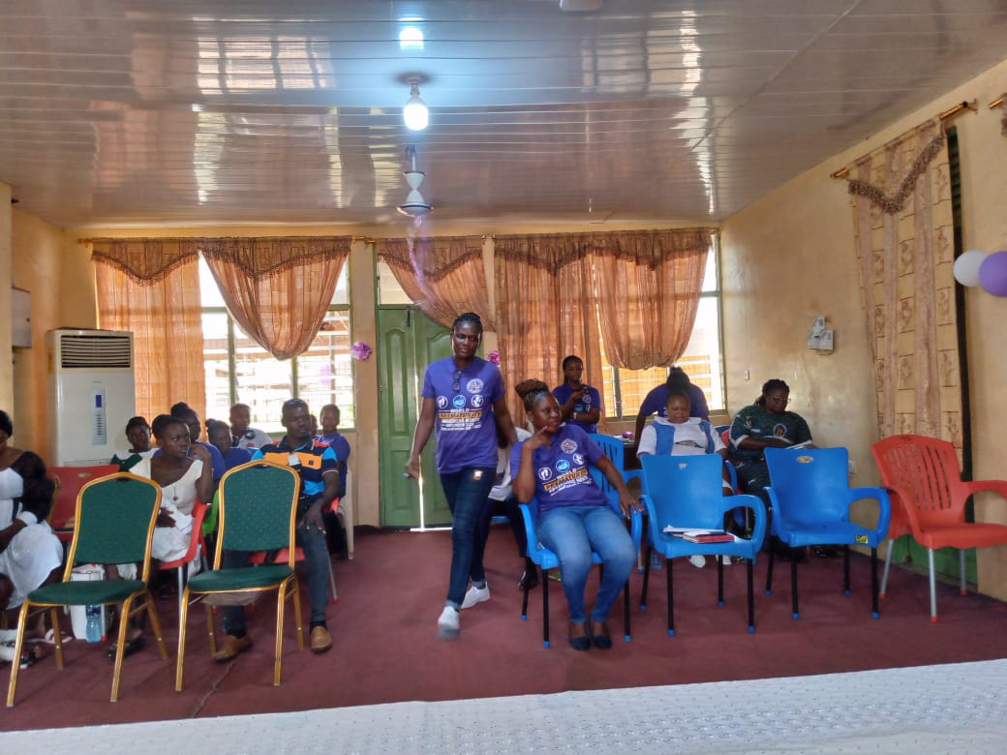
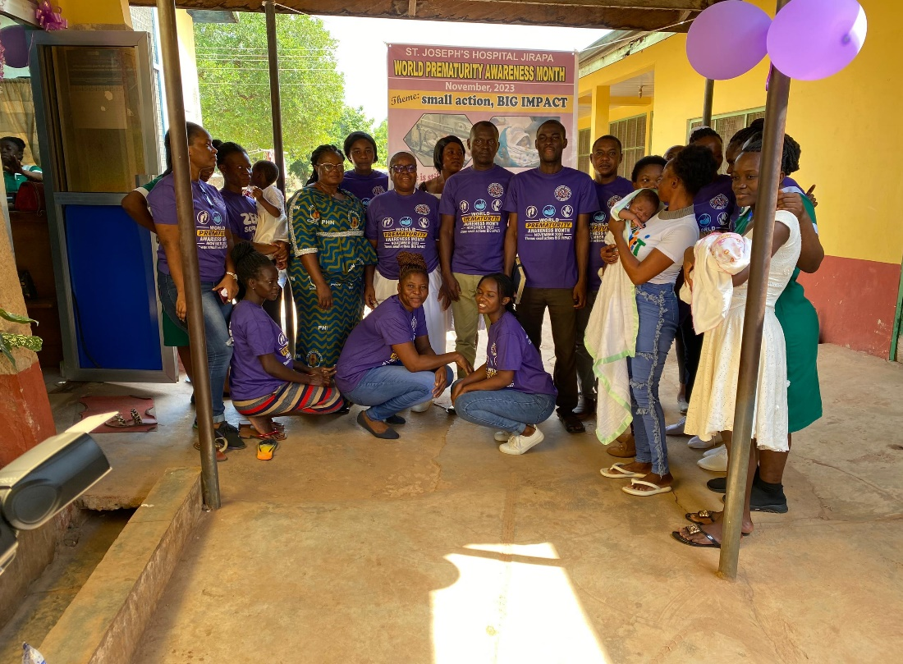
WORLD PREMATURITY MONTH CELEBRATION

Slide 27
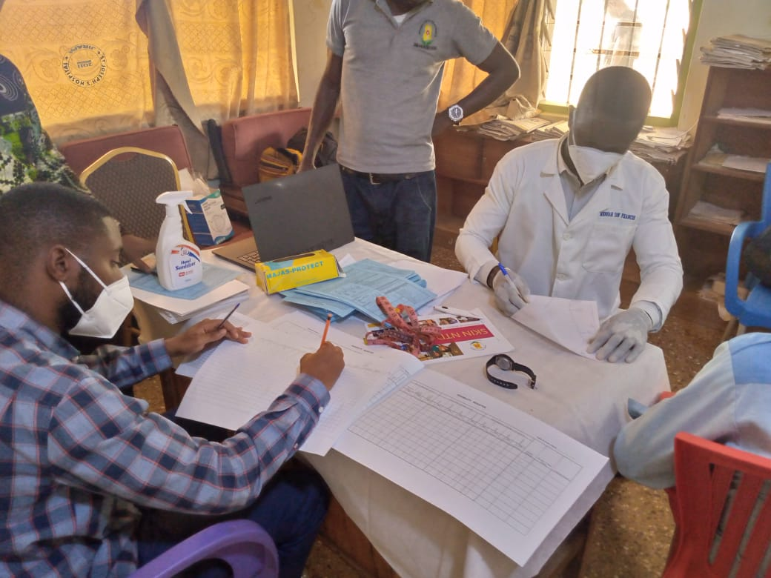
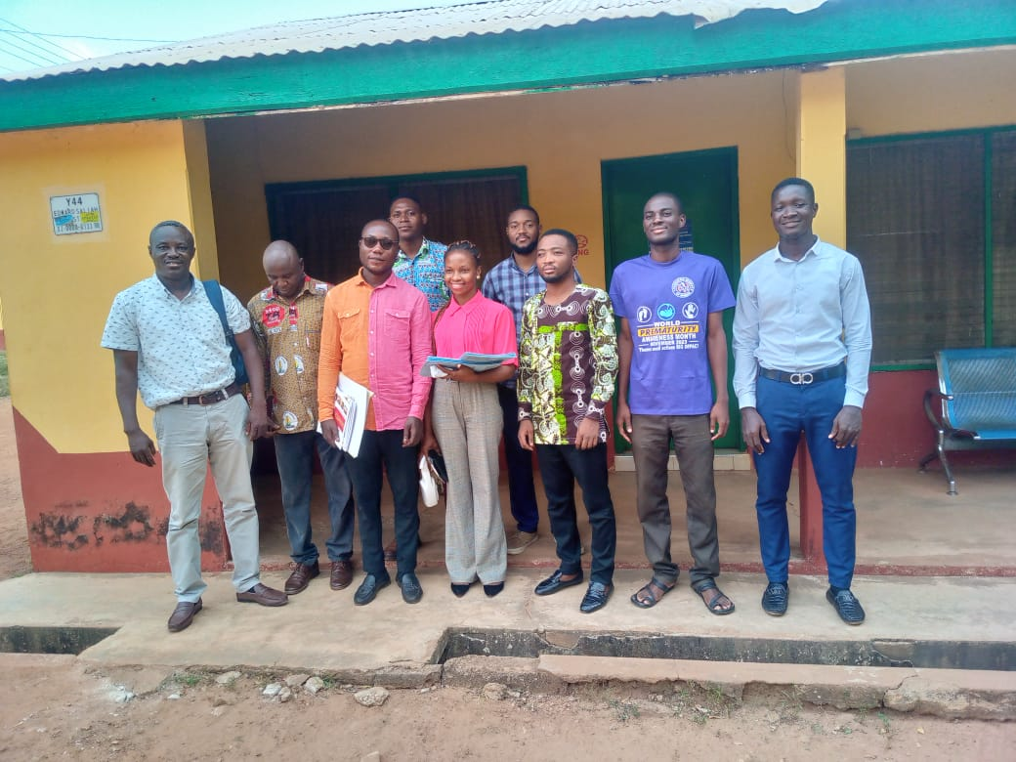
HOSPITAL AS REGIONAL NTD REFERRAL CENTER

Slide 28
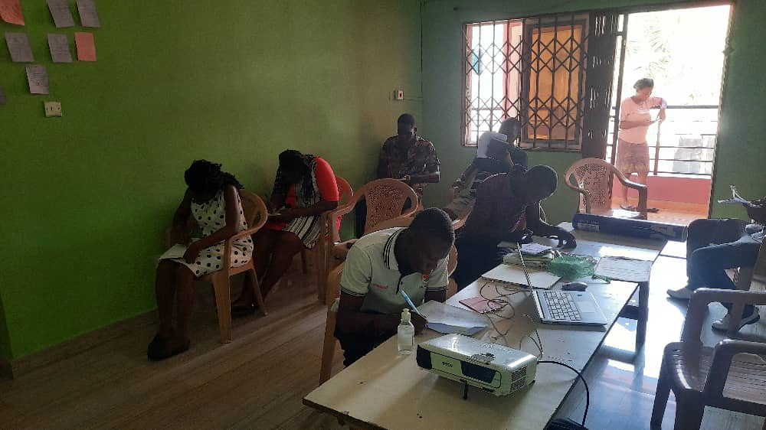
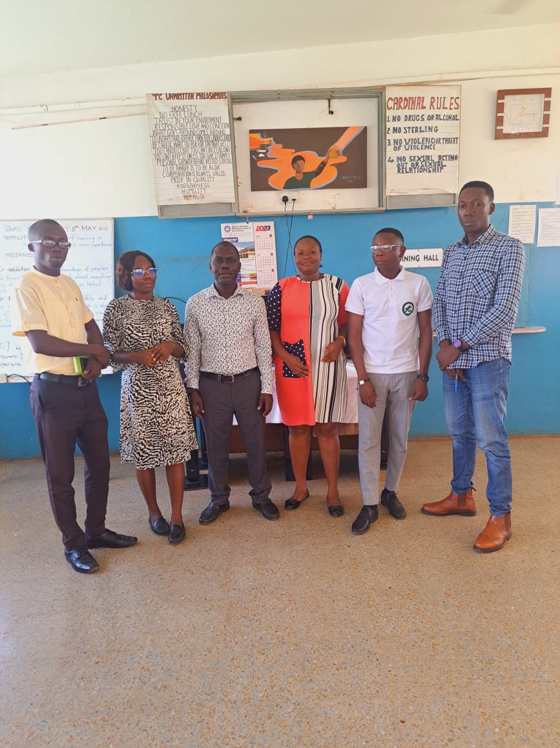
MENTAL HEALTH AUTHORITY – REHAB AND ADDICTION TRAINING PROGRAM

Slide 29
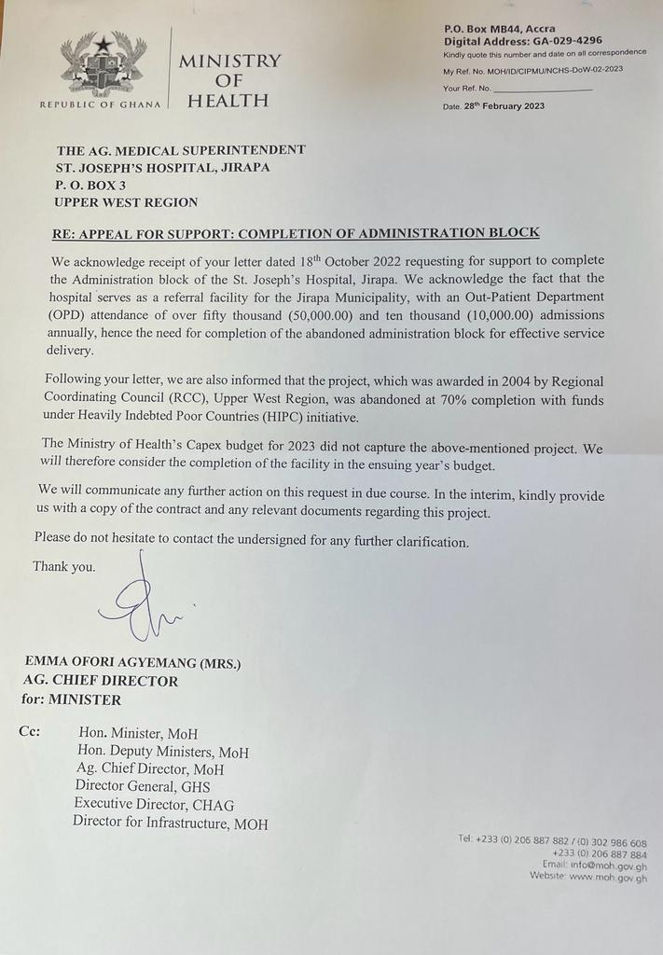
MINISTRY OF HEALTH – COMPLETION OF NEW ADMINISTRATION BLOCK

Slide 30
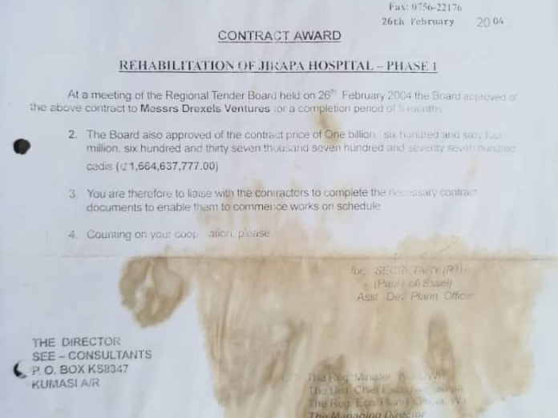
NEW ADMINISTRATION BLOCK – CONTRACT DOCUMENT

Slide 31
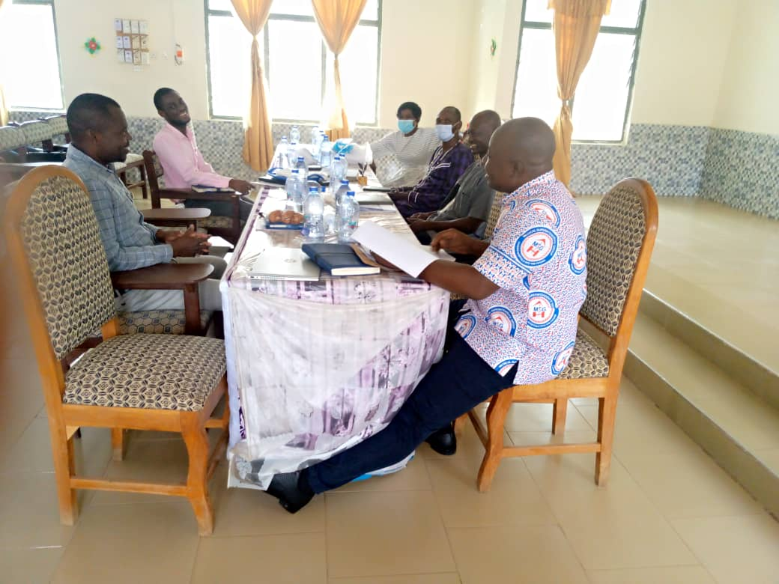
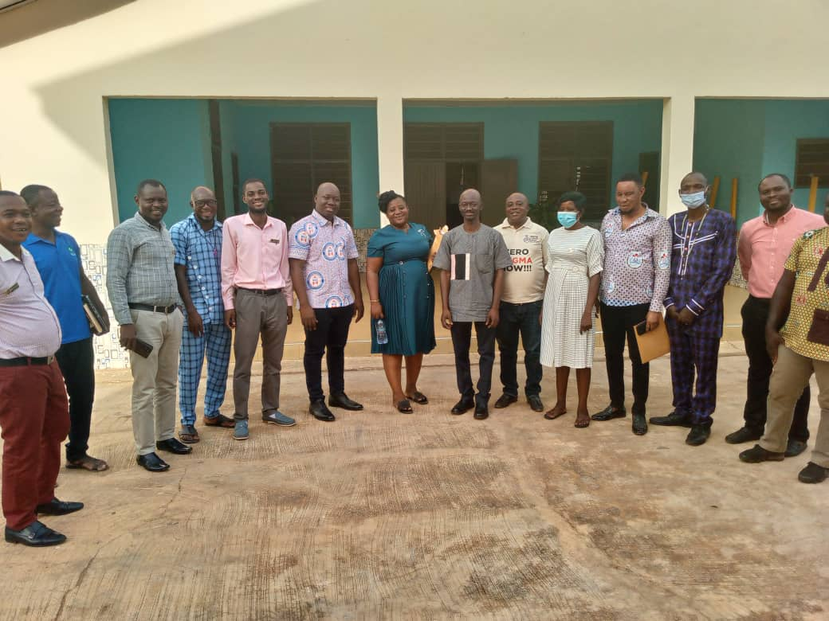
JIRAPA/NANDOM JOINT HOSPITAL MANAGEMENT RETREAT

Slide 32


HOSPITAL WEBSITE - www.jirapasjh.com

Slide 33
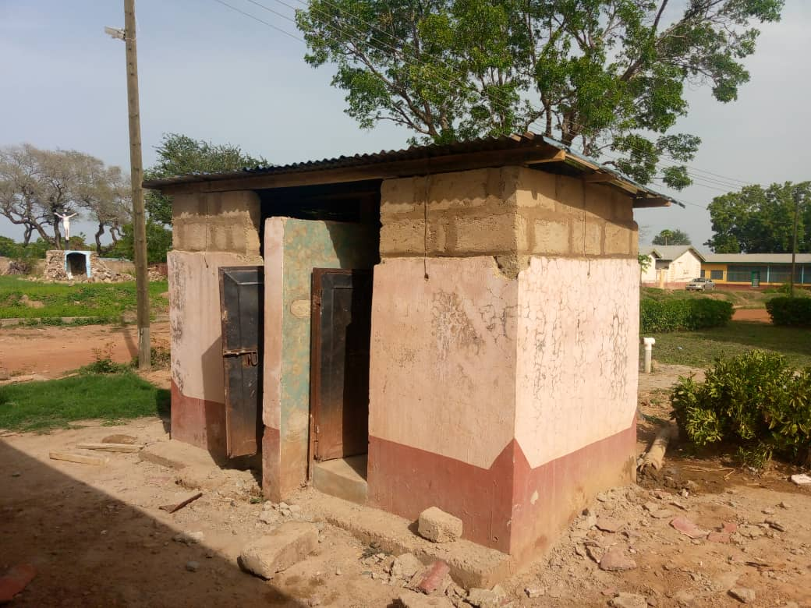
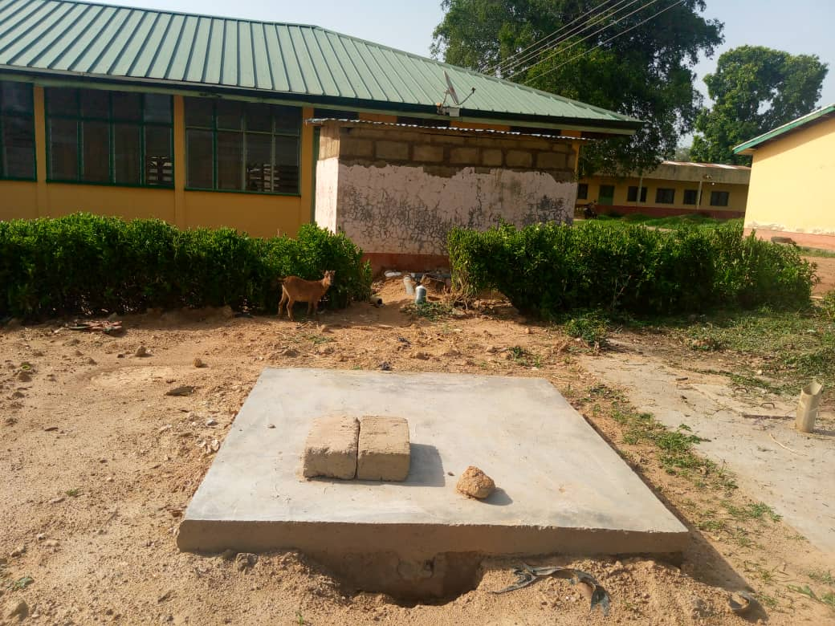
RENOVATED MATERNITY BATHROOMS

Slide 34
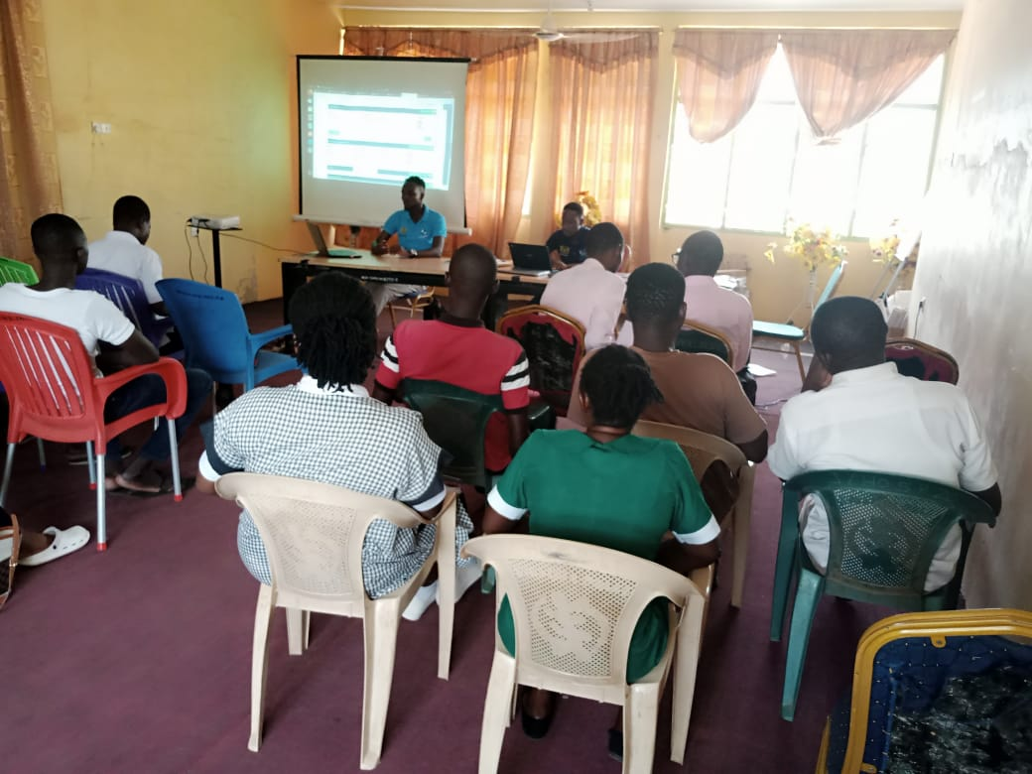
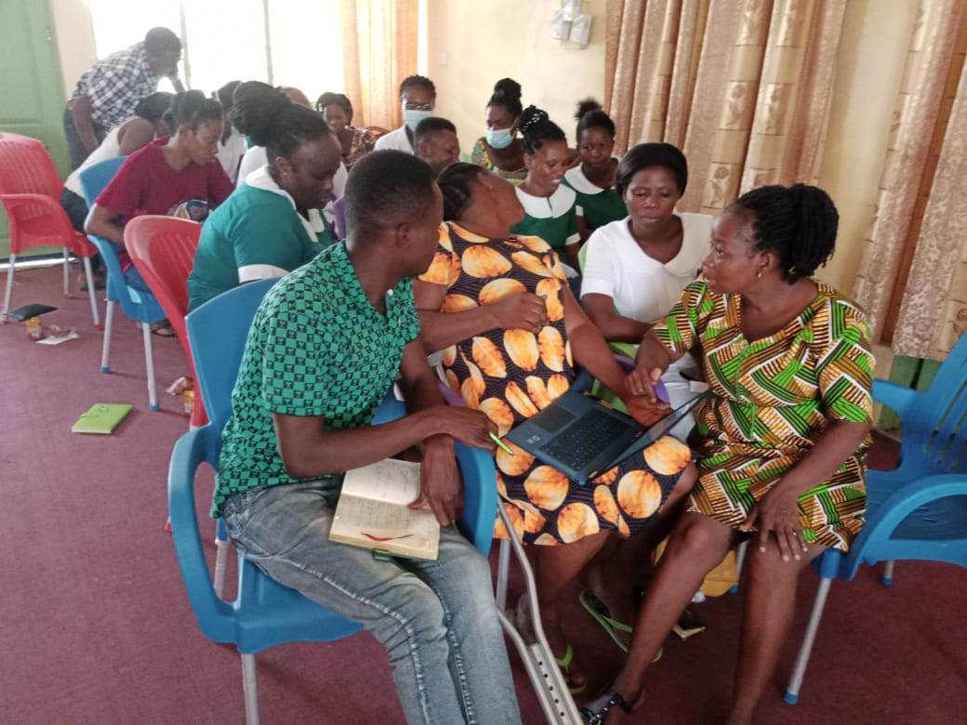
ELECTRONIC HEALTH RECORDS SYSTEM – LHIMS TRAINING

Slide 35
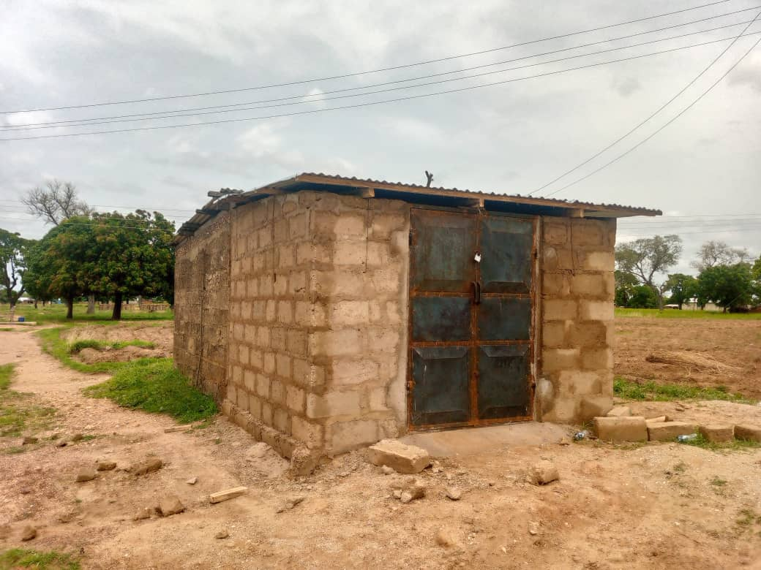
NEW HOSPITAL BOREHOLE – DONATED BY DR. GODFREY BACHEYIE

Slide 36
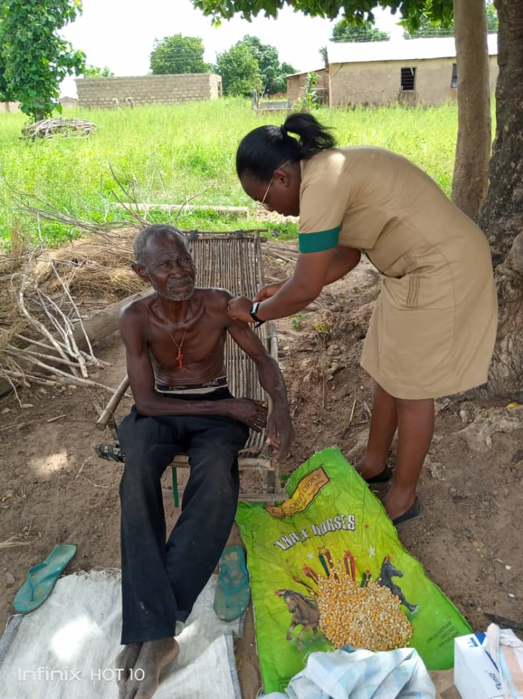
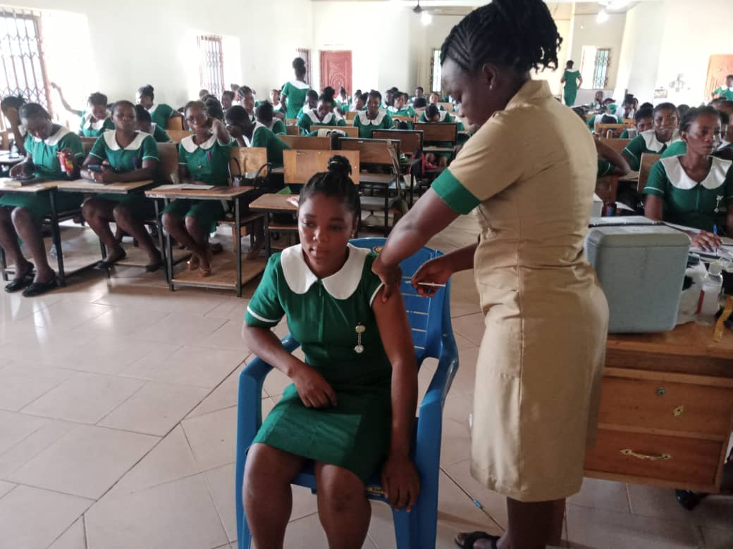
SAVING LIVES AND LIVELIHOOD PROJECT

Slide 37
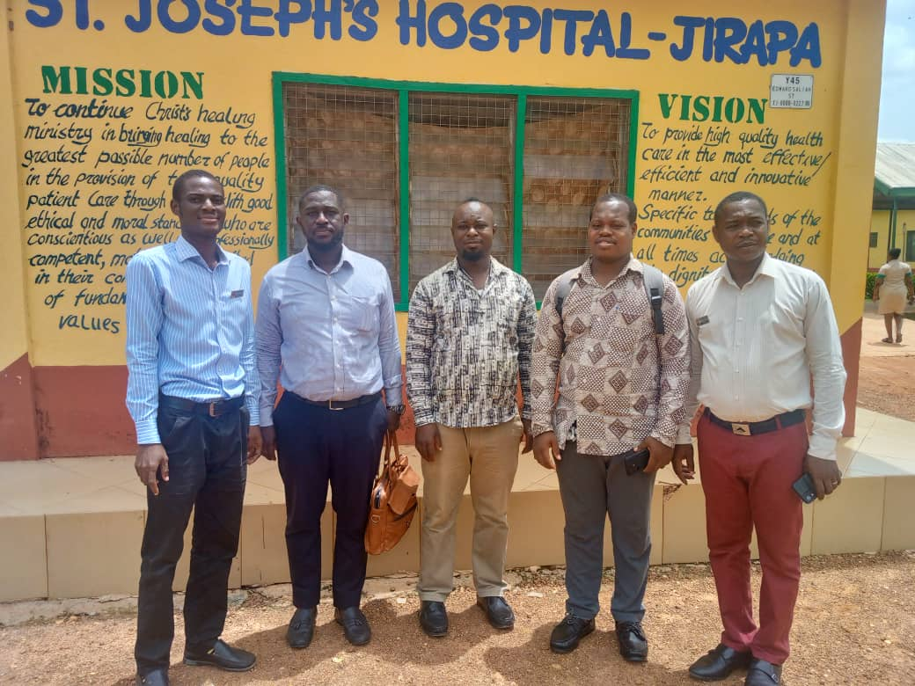
GHANA ELECTRONIC PROCUREMENT SYSTEM IMPLEMENTATION

Slide 38


IMPLEMENTATION OF LHIMS PROJECT

Slide 39


LABORATORY ANNEX

Slide 40


COVID-19 PRESIDENTIAL AWARD
Mr. Nicholas Yeboah, BMS
Mr. Richard Dery, PHN

Slide 41

NURSES AND MIDWIVES’ WEEK – BLOOD DONATION

Slide 42

QUARTERLY QA/DTC COMMITTEE MEETINGS

Slide 43

NEW ULTRASOUND MACHINE

Slide 44

WORLD BANK DONATIONS

Slide 45


PEER VISIT TO ST. THERESA HOSPITAL, NANDOM

Slide 46


MENTAL WARD/REHAB IMPLEMENTATION

Slide 47


MENTAL WARD/REHAB IMPLEMENTATION

Slide 48

REHAB COMMENCEMENT

Slide 49


NITA WIRELESS INTERNET CONNECTION

Slide 50

NEW PORTABLE ULTRASOUND MACHINE

Slide 51


ANNUAL LEADERSHIP RETREAT

Slide 52




QUARTERLY SCHOOL HEALTH SCREENING
ST. JOSEPH PRIMARY
ST. AGNES JHS
ST. JOSEPH JHS
ST. FRANCIS JHS

Slide 53

DONATION FROM CEO OF ROYAL COSY RESORT – MR. ERIC JOHNSON

Slide 54

THEATRE RECOVERY ROOM

Slide 55

ANNUAL STAFF HEALTH SCREENING

Slide 56


RENOVATION OF NICU MOTHERS’ HOSTEL

Slide 57


RENOVATED NICU MOTHERS’ HOSTEL

Slide 58

HOSPITAL MAGAZINE – FIRST EDITION

Slide 59

HOSPITAL MAGAZINE – SECOND EDITION

Slide 60

HOSPITAL CANTEEN - MOU

Slide 61



HOSPITAL CANTEEN

Slide 62


HOSPITAL CANTEEN

Slide 63


BAR-CODED PATIENT ID CARD

Slide 64

BAR-CODED PATIENT ID CARD

Slide 65

HB ELECTROPHORESIS MACHINE

Slide 66

4 LARGE SCREEN BP APPARATUS

Slide 67


EXTENSION OF BILLING UNIT

Slide 68

DONATION FROM ST. THERESA CATHOLIC WOMEN GROUP

Slide 69


BREAST CANCER SCREENING

Slide 70


SCHOOL HEALTH SCREENING – GANAA JHS

Slide 71


ADOLESCENT HEALTH CLUB

Slide 72


GREATER WORKS RESTORATION FOUNDATION – SURGICAL TEAM VISIT

